Slide 1
بسم الله الرحمن الرحيم
مقدمة عن ggplot2 في Rstudio: خطوة خطوة.
صالح بوعبد الله

Slide 2
Introduction to ggplot2 with RStudio: A step by step approach
Salah bouabdallah

Slide 3
“The simple graph has brought more information to the data analyst’s mind than any other device.”
- John Tukey

Slide 4
Objective and Plan
Understanding the idea behind ggplot2 and make basic plots:
The geoms:
geom_points,
geom_bars,
geom_histogramm,
geom_ density
geom_lines
geom_smooth
Geom_jitter
How to manipulate your data and ameliorate your plot:
How to filtre-out data.
Transformation
Label the x and y axes
Manipulating the axes
Dealing with Na’s and extreme values
Facet_wrap
Theme
Stats
Annotate (adding text and lines to the plot)
Comprehensive examples:
Gapminder dataset: life expectancy and gdp per capita: is there a significant difference between African and European countries.
Faithful dataset: correlation between the duration of erruption of volcanos and the waiting time between two erruptions.

Slide 5
Some useful ressources
A simple and comprehensive overview:
https://teacherscollege.screenstepslive.com/a/1112493-functions-in-r-studio
About the help in R:
https://www.r-project.org/help.html
Manuals:
https://cran.r-project.org/manuals.html
An extended Introduction from R Cran:
https://cran.r-project.org/doc/manuals/r-release/R-intro.html

Slide 6
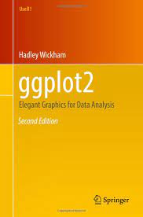
Ressources
THOMAS LIN PEDERSEN, a soft developer at R, he produced a very good comprehensive video (webinar) about ggplot2. you can find it in https://github.com/thomasp85/ggplot2_workshop; you can copy and paste the script on your R screen. you can also do the exercises their. You will find also a presentation in pdf.
FREE BOOKS ON GGPLOT2:
HADLEY WICKHAM: ggplo2, Elegant Graphics for Data Analysis, 2nd Edition, Springer
GARETT GROLEMUND and HADELEY WICKHAM, “R for Data Science”.
find it in: https://r4ds.had.co.nz/ and there is a book in amazon too.
For more advanced level : LELAND WILKINSON: The grammar of graphics, 1st edition 1999.

Slide 7
The idea behind ggplot2
Notes:
gg: grammar of graphics
Source: THOMAS LIN PEDERSEN

Slide 8
data+mapping+geoms
ggplot(data = BOD, mapping = aes(x=Time,y=demand))+
geom_point()+
geom_line()
#more options (size and colour) --- and a more concise writing:
ggplot(BOD,aes(Time,demand))+
geom_point(size=3)+
geom_line(colour="red")
Notes:
A quick example: BOD The three most important parameters.

Slide 9
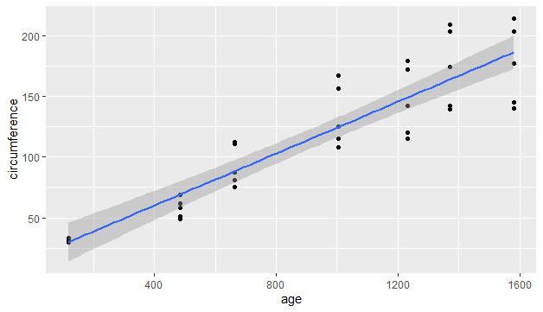
geom_point+geom_smooth
Orange %>%
ggplot(aes(age,circumference))+
geom_point()+
geom_smooth(method=lm).
Notes:
Another simple example, but the existance of a cathegoric var allows us to add some manipulation : filter() + facet_wrap to compare the tree-types.

Slide 10
Facet_wrap +filter
Orange %>%
filter(Tree!="2") %>% ggplot(aes(age,circumference))+
geom_point()+
geom_smooth(method=lm)+
facet_wrap(~Tree)
Notes:
To see if the correlation differs according to the type of tree. The difference is not clear enough, so let us omit the faceting and compare the types in the same plot.

Slide 11
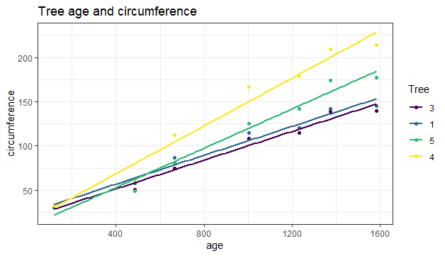
Adding an aes: the colour geom_point+geom_smooth+them_bw+labs
Orange %>%
filter(Tree!="2") %>%
ggplot(aes(age,circumference,colour=Tree))+
geom_point()+
geom_smooth(method=lm,se=F)+
theme_bw()+
labs(title="Tree age and circumference")
Notes:
We omit the facetting and compare the types by adding a new aesthetic: the colour.

Slide 12
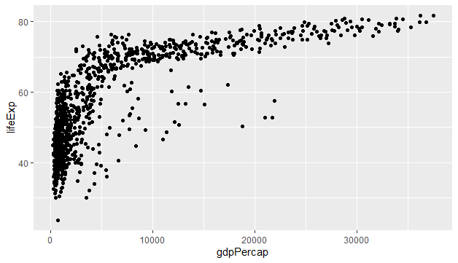
Filtering, Facetting and adding variables 1st glimpls: filtering and geom_point
library(gapminder)
gapminder%>%
filter(continent=="Africa"|continent=="Europe")%>%
filter(gdpPercap<40000)%>%
ggplot(aes(gdpPercap,lifeExp))+
geom_point()
Notes:
Economic example with gapminder. (other filtering): It is clear that we need to distinguich between the two populations: African and European countries,

Slide 13
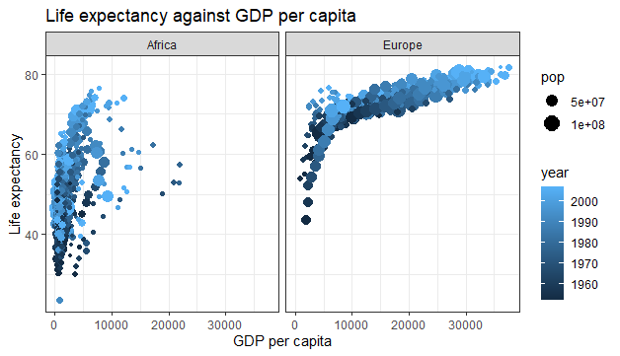
adding vars to the story: aes()
gapminder%>%
filter(continent=="Africa"|continent=="Europe")%>%
filter(gdpPercap<40000)%>%
ggplot(aes(gdpPercap,lifeExp))+
geom_point(aes(color=year,size=pop))+
facet_wrap(~continent)+
theme_bw()+
labs(x="GDP per capita", y="Life expectancy",
title="Life expectancy against GDP per capita")

Slide 14
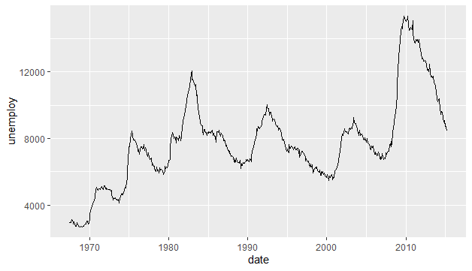
simple geom_line()
economics %>%
ggplot()+
geom_line(aes(x=date,y=unemploy))
Notes:
One line, multiple lines.

Slide 15
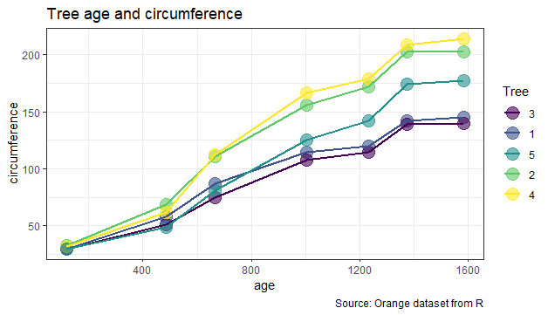
Multiple lines: separate circumference by colour +labs+them_bw
Orange %>%
ggplot(aes(age,circumference,colour=Tree))+
geom_point(size=5, alpha=0.6)+
geom_line(size=1,lintype=2)+
theme_bw()+
labs(title="Tree age and circumference",
caption = "Source: Orange dataset from R" )
Notes:
We can obtain multiple lines to compare types by adding an aes in ggplot.

Slide 16
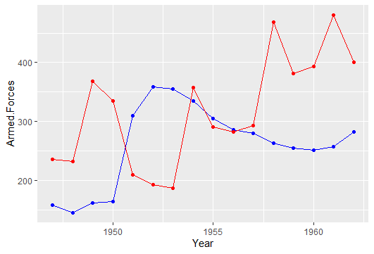
Multiple lines: two separate variables
longley %>%
ggplot()+
geom_point(aes(x=Year,y=Armed.Forces),color="blue")+
geom_line(aes(x=Year,y=Armed.Forces),color="blue")+
geom_point(aes(x=Year,y=Unemployed),color="red")+
geom_line(aes(x=Year,y=Unemployed),color="red")
Notes:
Another case: two separate variables

Slide 17
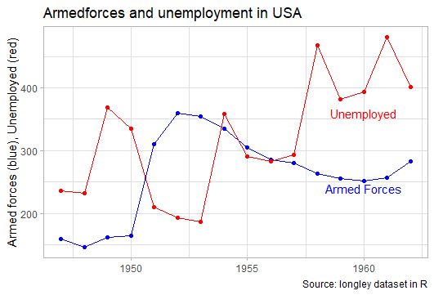
Multiple lines annotate+labs+them_light
longley %>%
ggplot()+
geom_point(aes(x=Year,y=Armed.Forces),color="blue")+
geom_line(aes(x=Year,y=Armed.Forces),color="blue")+
geom_point(aes(x=Year,y=Unemployed),color="red")+
geom_line(aes(x=Year,y=Unemployed),color="red")+
theme_light()+
# labs(x=NULL, y="",
caption="Source: longley dataset in R",
title="Armedforces and unemployment in USA")+
#annotate("text",x=c(1960,1960),y=c(240,360),label=c("Armed Forces","Unemployed"),color=c("blue","red"))
Notes:
Run the code before the two last lines then run the complete code

Slide 18
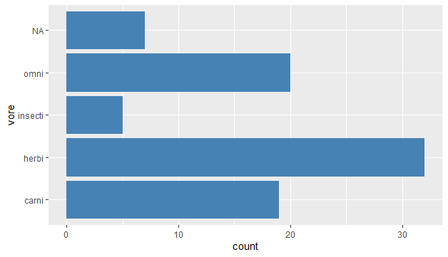
geom_bar +drop_na()+coord_flip()
msleep %>%
#drop_na(vore)%>%
ggplot(aes(x=vore))+
geom_bar(fill="steelblue")+
coord_flip()
Notes:
Let us drop the Nas and arrange ‘vore’ by count.

Slide 19
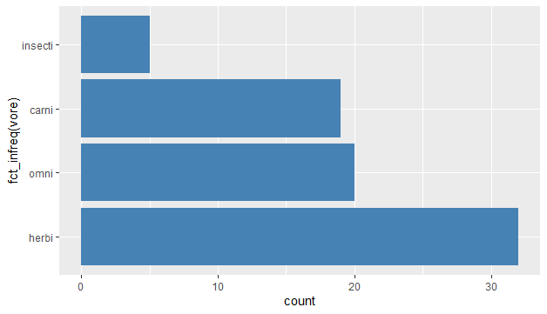
Geom_bar fct_infreq(): arrange the categories by frequency
msleep %>%
drop_na(vore)%>%
ggplot(aes(fct_infreq(vore)))+
geom_bar(fill="steelblue")+
coord_flip()
Notes:
#Be specific when dropping NAs!! do not drop na from all the data because then you might remove too much data. See
#the following ex., for example the count of the "herbi" category has dropped from more than 30 to just 10.
#look below at the nbre of raws that contain missing data: more than 60 cases!

Slide 20
Be cairful when dropping NAs
#Be specific when dropping na!! do not drop na from all the data because then you might remove #too much data. See
#look at the nbre of raws that contain missing data: more than 60 cases!
missing<-!complete.cases(msleep)
msleep[missing, ]

Slide 21
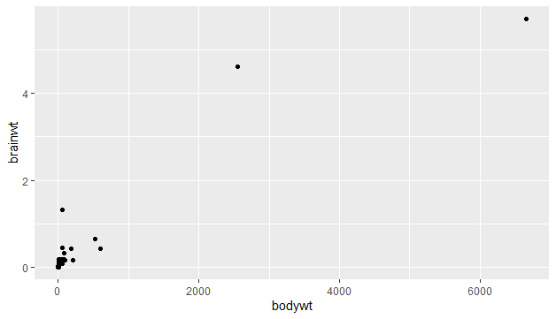
Extreme values
msleep%>%
ggplot(aes(bodywt,brainwt))+
geom_point()
Some mammals have extreme values in both variables, such as wails, elephants, … in the following we drop these extreme values.

Slide 22
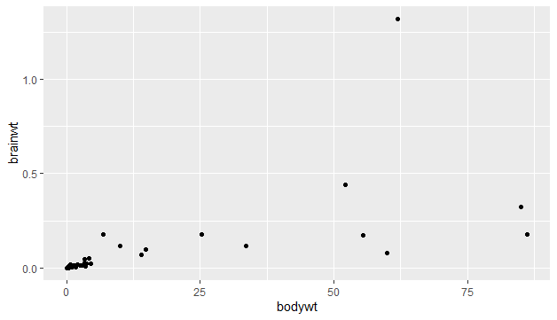
Removing some extreme values filter()
msleep%>%
filter(bodywt<100)%>% #To omit big mammals
ggplot(aes(bodywt,brainwt))+
geom_point()
#filter by brainwt too
msleep%>%
filter(bodywt<100 & brainwt<0.5)%>%
ggplot(aes(bodywt,brainwt))+
geom_point()
Notes:
To omit big mammals such as elephants and whales.

Slide 23
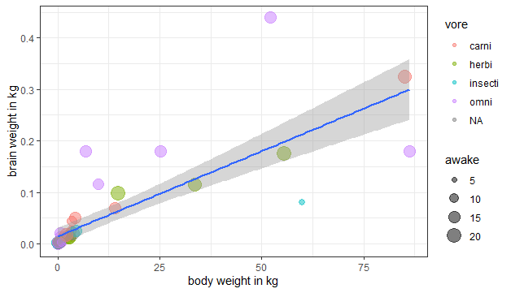
Add more vars to the plot
msleep%>%
filter(bodywt<100 & brainwt<0.5)%>%
ggplot(aes(bodywt,brainwt))+
geom_point(aes(size=awake,color=vore), alpha=0.5)+
geom_smooth(method=lm)+
theme_bw()+
labs(x="body weight in kg", y="brain weight in kg")
Notes:
#more var. The colors show that the omnivores tend to have heavier brains

Slide 24
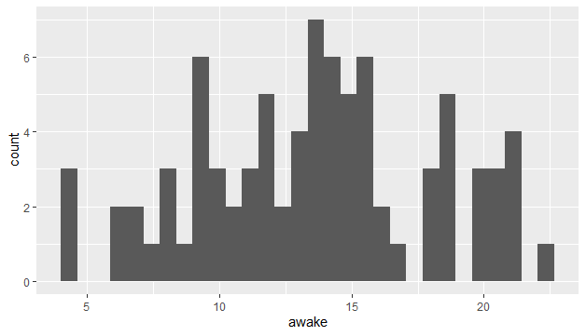
geom_histogram() binwidh = ...
names(msleep)
msleep%>%
ggplot(aes(awake))+
geom_histogram()
# It is preferable to ameliorate the appearance by dropping the empty bins ,

Slide 25
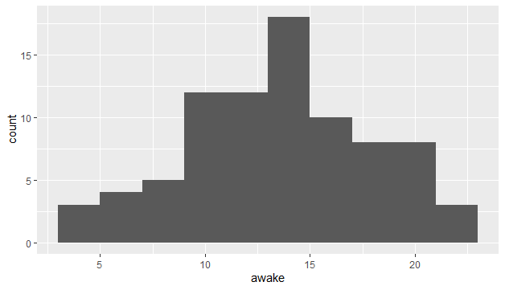
geom_histogram() binwidh = ...
msleep%>%
ggplot(aes(awake))+
geom_histogram(binwidth = 2)

Slide 26
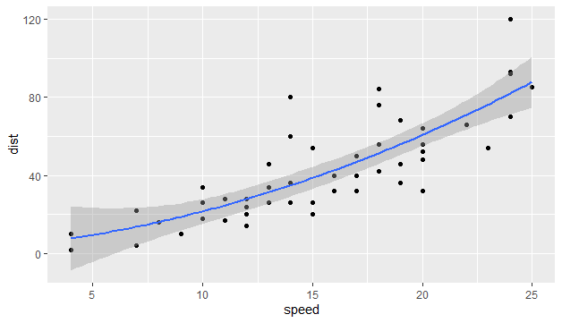
geom_smooth(formula=y~poly(x,2)…
c<-cars %>%
ggplot(aes(speed,dist))+
geom_point()
c+geom_smooth(formula=y~x, method="lm")
c+geom_smooth(formula=y~poly(x,2), method="lm")

Slide 27
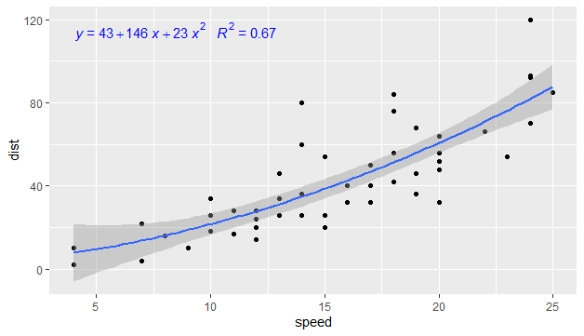
Show the equation on the plot: stat_poly_eq()
library(ggpmisc)
my_for=y~poly(x,2)
cars %>%
ggplot(aes(speed,dist))+
geom_point()+
geom_smooth(formula=my_for, method="lm", level=0.9)+
stat_poly_eq(formula=my_for,
aes(label=paste(..eq.label..,..rr.label..,sep="~~~")),
parse=T, size=4,color="blue")

Slide 28
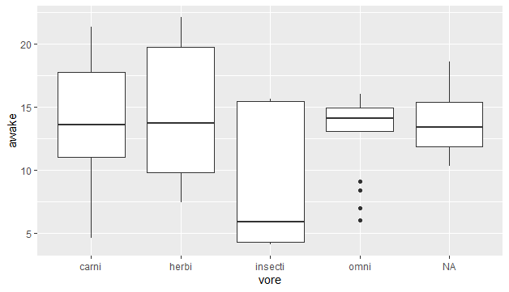
box_plot (): plotting categorical against numeric variables
msleep %>%
#drop_na(vore)%>%
ggplot(aes(vore,awake))+
geom_boxplot()
Notes:
the box contains 50% of data, the whisker 1.5 the length of th box and the out layers are beyond

Slide 29
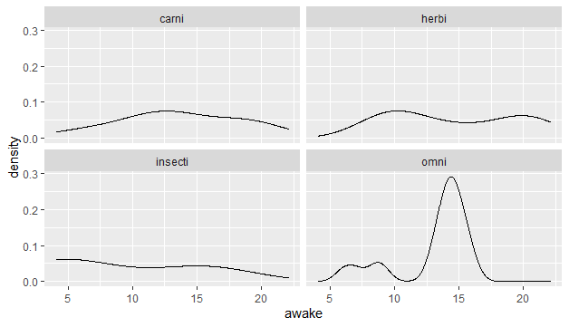
geom_density()
msleep %>%
drop_na(vore)%>%
ggplot(aes(awake))+
geom_density()+
#facet_wrap(~vore)
Notes:
For another wau of comparison let now put all the vore on one graph/

Slide 30
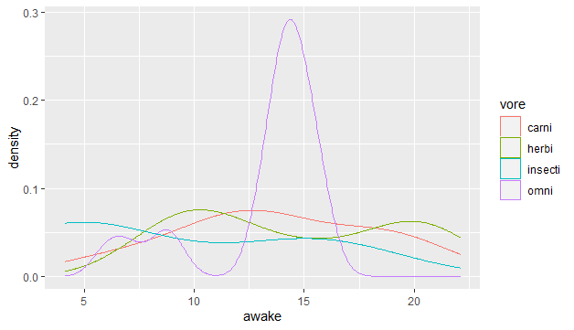
Superposed density plots
msleep %>%
drop_na(vore)%>%
#filter(vore=="omni"|vore=="carni")%>%
#filter(vore%in%c(""omni","carni"))%>%#same result
ggplot(aes(awake))+
#geom_density() #one curve
geom_density(aes(color=vore))# ceveral curves
Notes:
Uncomment to see the different results.

Slide 31
Comprehensive example nbre1. using geom_density to illustrate the t-test results
gapminder %>%
filter(continent %in% c("Africa","Europe")) %>%
t.test(lifeExp ~ continent,
data=.,
alternative = "two.sided",
paired=FALSE )

Slide 32
T-test results
Welch Two Sample t-test
data: lifeExp by continent
t = -49.551, df = 981.2, p-value < 2.2e-16
alternative hypothesis: true difference in means between group Africa and group Europe is not equal to 0
95 percent confidence interval:
-23.95076 -22.12595
sample estimates:
mean in group Africa mean in group Europe
48.86533 71.90369

Slide 33
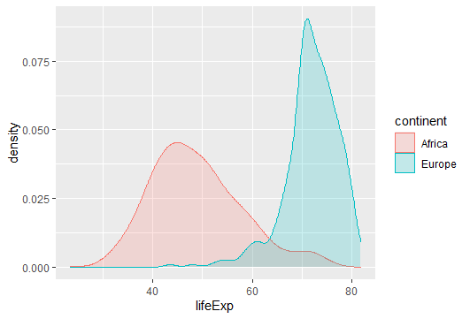
1st comprehensive example Plotting the difference: geom_density
gapminder %>%
filter(continent %in% c("Africa","Europe")) %>%
ggplot(aes(lifeExp,color=continent,fill=continent))+
geom_density(alpha=0.2)
Notes:
Line in R: 1392

Slide 34
T-test: plotting the difference
gapminder %>%
filter(continent %in% c("Africa","Europe")) %>%
ggplot(aes(lifeExp,color=continent,fill=continent))+
geom_density(alpha=0.2)#+
xlim(0,100)+
theme_test()+
labs(x="life expectancy",y=NULL,
title="Density plot of life expectancy in Africa and Europe",
caption="Source:gapminder dataset")+
annotate("text",x=c(40,70),y=c(0.05,0.05),label=c("Means: 48.86","71.90"),color=c("red","blue"))+
geom_vline(xintercept=48.86,linetype=2,color="red")+
geom_vline(xintercept=71.9,linetype=2,color="blue")

Slide 35
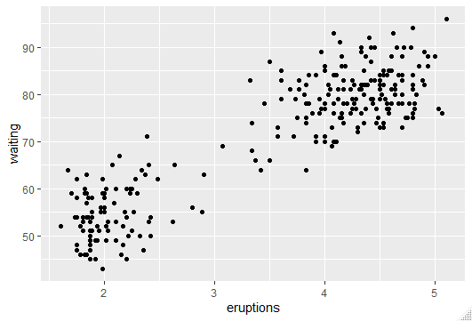
Comprehensive example nbre2 geom_point + geom_density + more layers
faithful %>%
ggplot(aes(eruptions,waiting))+
geom_point()
Notes:
1411

Slide 36
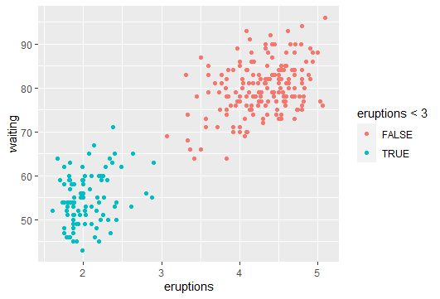
divide the scatter dote into two parts
faithful %>%
ggplot(aes(eruptions,waiting))+
geom_point(aes(colour=eruptions<3))

Slide 37
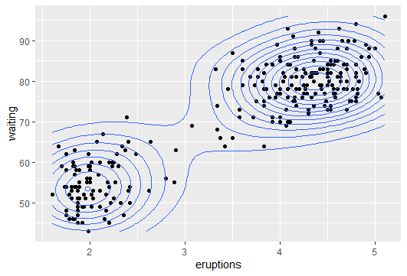
geom_density_2d()
faithful %>%
ggplot(aes(x=eruptions,y=waiting))+
geom_point()+geom_density_2d()
Notes:
geom_density_2d(): another way to separate two groups of points==============================
# Layers are stacked in the order of code appearance; to see that, try
#starting by the geom_density_2d.

Slide 38
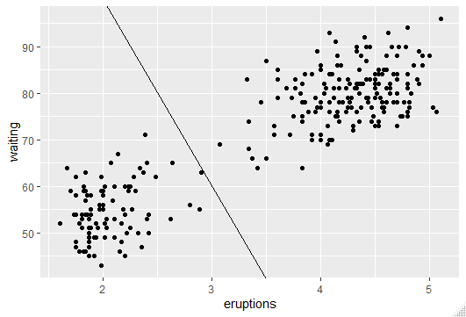
geom_abline
faithful %>%
ggplot()+
geom_point(aes(x=eruptions,y=waiting))+
geom_abline(intercept=180,slope=-40)

Slide 39
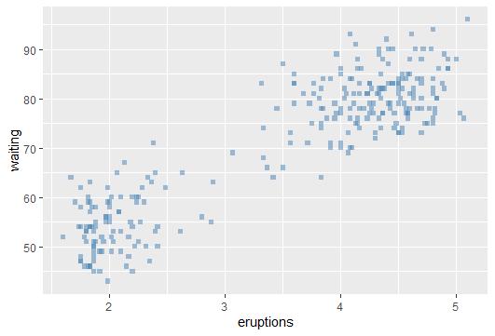
Setting up vs mapping : the colour, the shape and the transparency
faithful %>%
ggplot()+
geom_point(aes(x=eruptions,y=waiting),
color="steelblue", shape="square",alpha=0.5)
# if you want to set sthg put it outside the aes()
Notes:
if you want to set sthg put it outside the aes()

Slide 40
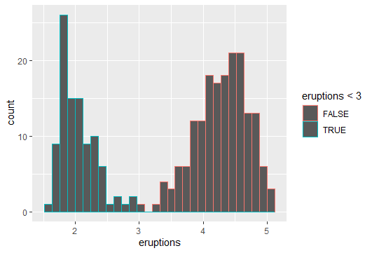
geom_histogram
faithful %>%
ggplot()+
geom_histogram(aes(eruptions,color=eruptions<3))
#replace "color" by "fill" to change the color inside.

Slide 41
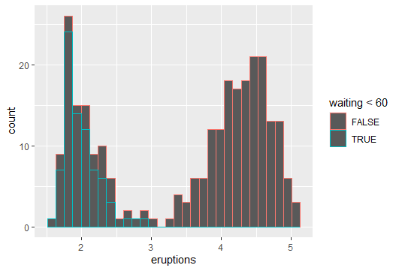
geom_histogram
faithful %>%
ggplot()+
geom_histogram(aes(eruptions,color=waiting<60))
#the graph shows that the waiting below 60 are the majority for eruptions less than 3;
# waiting above 60 are the diff between the total and the blue line.
# if we change the position argument from the default value (stack) to "identity" the
#two categories will be put behind each other and we might need to use transparency to see behind. let's do that.

Slide 42
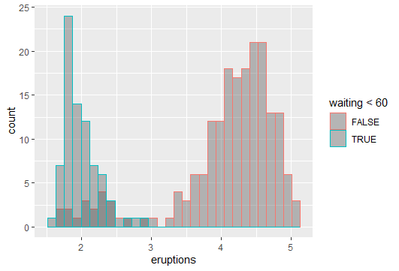
geom_histogram +position=“identity”, alpha=…
faithful %>%
ggplot()+
geom_histogram(aes(eruptions,color=waiting<60),
position="identity",alpha=0.4)
Notes:
we can also use : position = dodge + you can also use fill instead of color for better appearance:

Slide 43
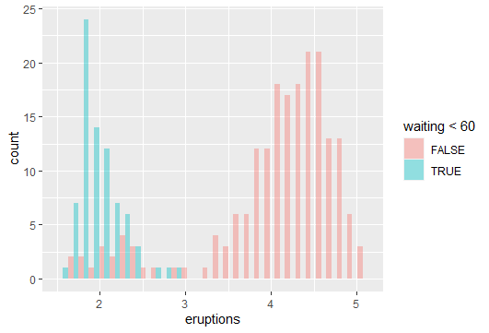
geom_histogram +position=“dodge”
faithful %>%
ggplot()+
geom_histogram(aes(eruptions,
fill=waiting<60), position="dodge",alpha=0.4)

Slide 44
Comprehensive example nbre 3 (mpg) geom_bar() +after_stat(), coord_cartesian
names(mpg)
head(mpg)
# displ: engine size;
# drv: drive system (forward, back, 4W driv);
# cty: efficiency in city;
# hwy: efficiency in high way …

Slide 45
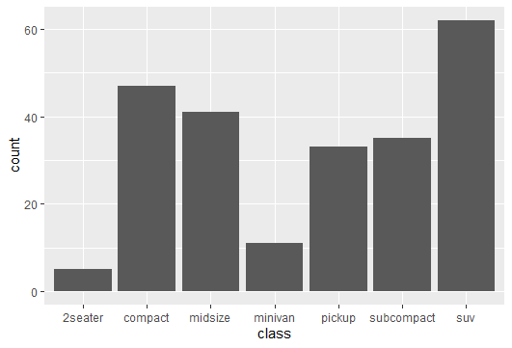
geom_bar
mpg %>%
ggplot()+
geom_bar(aes(class))+
Coord,flip
Notes:
What if I want the percentage instead of count?

Slide 46
What if I want the percentage instead of the count?
mpg %>%
ggplot()+
geom_bar(aes(x=class,
y=after_stat(count*100/sum(count))))

Slide 47
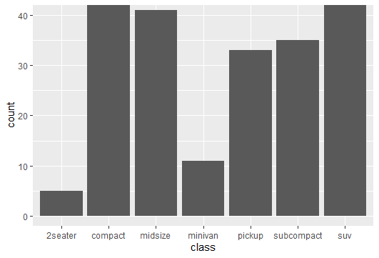
To concatenate the y axes
mpg %>%
ggplot()+
geom_bar(aes(x=class))+
coord_cartesian(ylim=c(0,40))

Slide 48
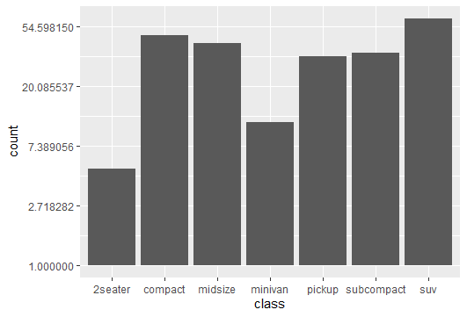
transform y: scale_y_continuous(trans=‘log’)
mpg %>%
ggplot()+
geom_bar(aes(x=class))+
scale_y_continuous(trans='log')
Notes:
another function is coord_trans(y='log'), but ???

Slide 49
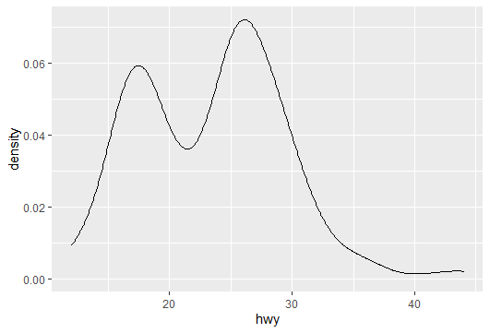
geom_density() and after_stat()
mpg %>%
ggplot()+
geom_density(aes(hwy))
Notes:
#execut then drop the last bracket and uncomment the next line to scale the y axes

Slide 50
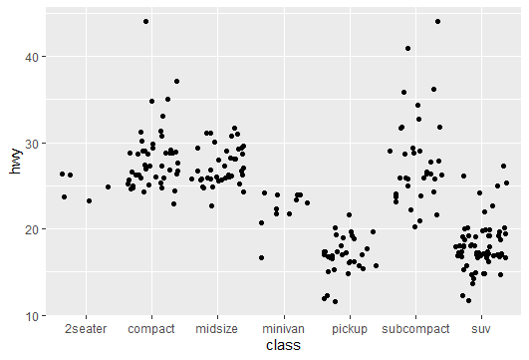
geom_jitter() + stat_summary()
mpg %>%
ggplot()+
geom_jitter(aes(x=class,y=hwy))
Notes:
The classes are not well separated

Slide 51
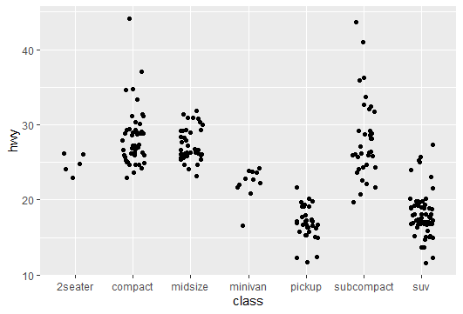
geom_jitter() Add width = 0.2 to separate the classes
mpg %>%
ggplot()+
geom_jitter(aes(x=class,y=hwy),
width=0.2)

Slide 52
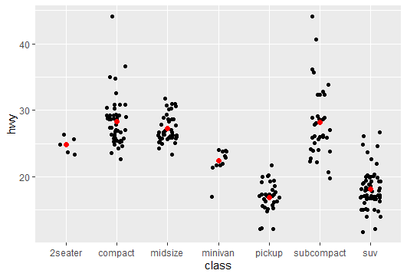
geom_jitter() Add stat_summary to show the mean or the median
mpg %>%
ggplot()+
geom_jitter(aes(x=class,y=hwy),width=0.2)+
stat_summary(aes(x=class,y=hwy),
fun=mean,geom="point",
color="red", size=2) #try fun=mediane

Slide 53
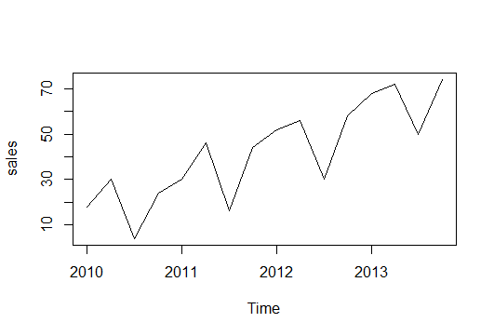
Series Specify the frequency of a series
sales=ts(c(18,30,4,24,30,46,16,44,52,56,30,58,68,72,50,74),
start=2010,frequency=4)
plot(sales)

Slide 54
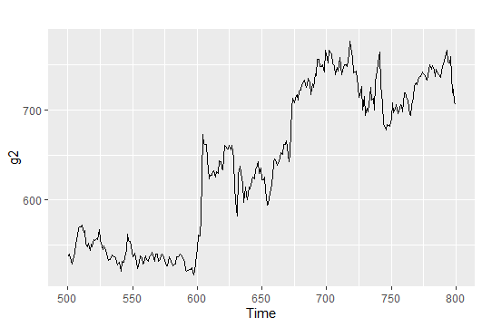
Specify a window in a series
g2 <- window(goog,start=500,end=800)
autoplot(g2)

Slide 55
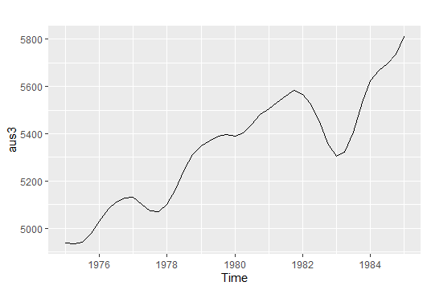
Specify a window in a series
aus3<-window(ausgdp,start=1975,end=1985)
autoplot(aus3)

Slide 56
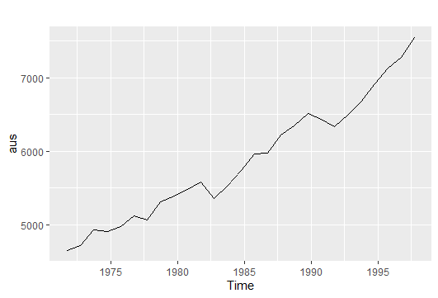
Specify a subset in a series
aus<-subset(ausgdp,quarter=4)
autoplot(aus)

Slide 57
“Mankind inveted a system to cope with the fact that we are intrinsically lousy at manipulating numbers, it’s called the graph ».
Charlie Munger

Slide 58
صالح بوعبد الله
شكرا لكم.
salah.bouabdallah@univ-msila.dz

